Slide 1
Tesla Stock Price Prediction
Forecasting Jan 2024 Closing Prices
Tamilarasee Sethuraj

Slide 2
Introduction
Objective: Predict Tesla stock closing price using Linear Regression.
Data: 2023 daily data (Train/Test), Jan 2024 (Predict).
Source: yfinance.

Slide 3
Data COLLECTION
Source: yfinance
Ticker: TSLA
Training Period: 2023-01-01 to 2024-01-01
Prediction Period: 2024-01-01 to 2024-02-01

Slide 4
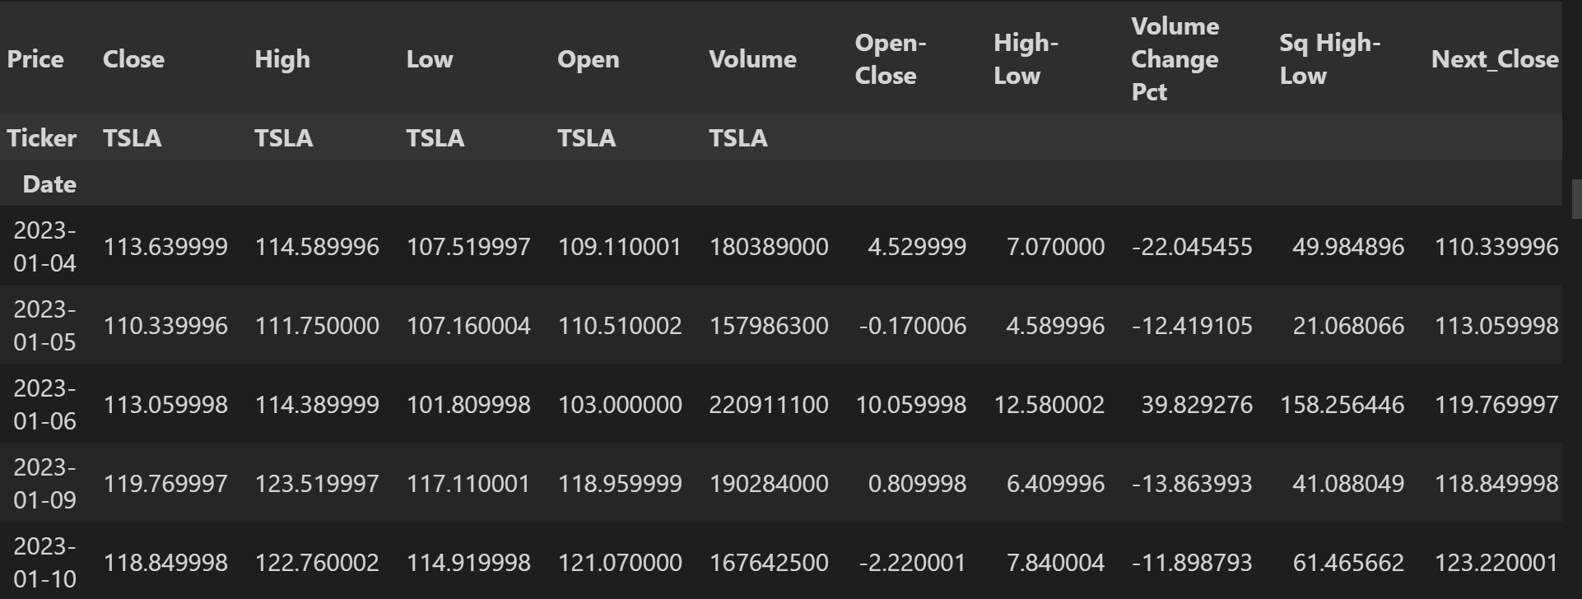
Feature Engineering
Open, High, Low, Close, Volume-Standard daily data.
Open-Close: Intraday momentum.
High-Low: Intraday range/volatility.
Volume Change Pct: Shift in trading activity.
Sq High-Low: Non-linear volatility effect.

Slide 5
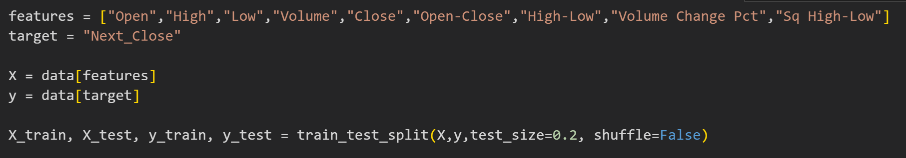
Model Training and PERFORMANCE
Model: Linear Regression (sklearn.linear_model.LinearRegression)
Split: Chronological (80% Train / 20% Test from 2023 data)

Slide 6
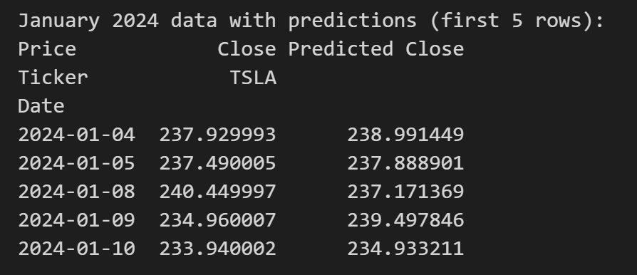
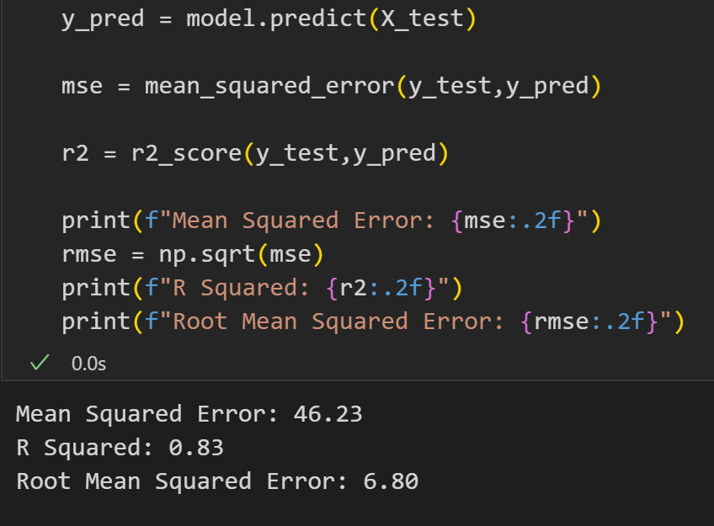
Model PERFORMANCE
R-Squared (R²): Explains ~83% of next-day price variance
Mean Squared Error (MSE): 46.23 (Avg. squared error)
Notes:
R2 shows how well your model explains the variance in the target variable
R2=1−SStot​SSres​​=1−∑(yi​−yˉ​)2∑(yi​−y^​i​)2​ Where:
SSresSS_{res}SSres​ = residual sum of squares (like MSE numerator)
SStotSS_{tot}SStot​ = total sum of squares (how much the values vary around the mean)
yˉ\bar{y}yˉ​ = mean of the actual values
MSE measures how close the predicted values are to the actual values. It does this by taking the average of the squared differences between predicted and actual values:
Why we use it:
Penalizes larger errors more due to squaring
Good for optimization (it’s differentiable, so it works well with gradient descent)
🚫 Drawbacks:
It's sensitive to outliers (because errors are squared)
The result is in squared units of the output (e.g., if predicting price in dollars, MSE is in dollars²)

Slide 7
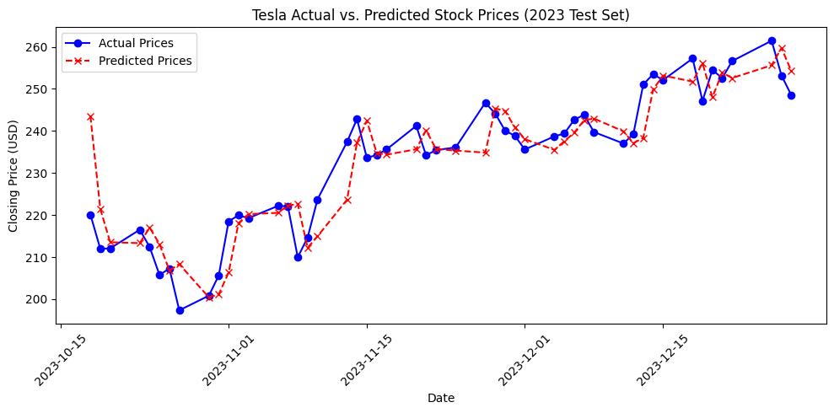
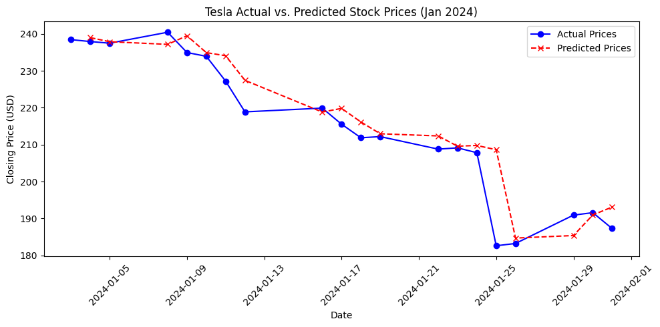
Prediction

Slide 8
Insights
Result: Linear model showed decent predictive power (R²=0.83) on 2023 data using daily features.
Limitations: Linear assumptions, ignores external factors (news, sentiment).
Next Steps: Non-linear models (Random Forest, LSTMs), more features (technical indicators), external data integration.

Slide 9
Thank you!

